Slide 1

VENTURE GROUP
COMPANY PROFILE
Venture Group

Slide 2
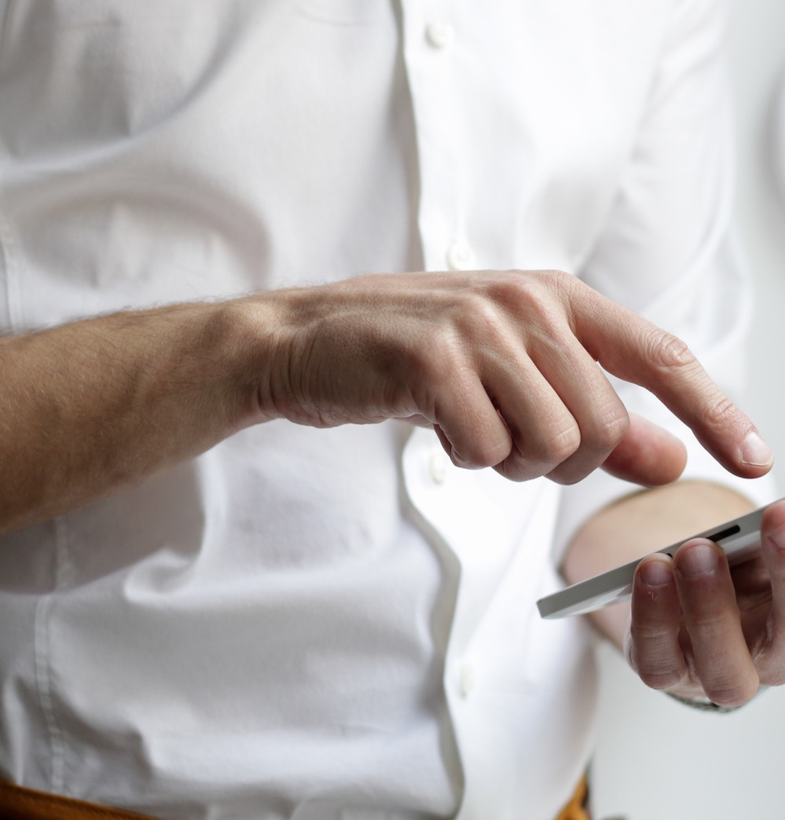
Company Info
COMPANY INFORMATION
Address: El. Venizelou 61 Athina 10564 GREECE
Telephone: +306970928436
E-mail: info@venturegroup.gr
Website: venturegroup.gr
VENTURE GROUP
Venture Group

Slide 3

About Us
VENTURE GROUP
Our story began in 2019 as a consulting firm.
At the end of 2019 we have become partner of a travel company which has 30 years of experience in Greece
At the beginning of 2021 we completed all formal processes and get started online sales for Korean Beauty Products
Venture Group

Slide 4

Our Mission
Our Vision
Korendy.gr: Our target is to be the prominent Korean Beauty Products seller first in Greece then in Europe.
To provide our clients/customers to have the best customer experience by means of service and product quality
Venture Group

Slide 5
SERVICES AND PRODUCTS
Tourism: GreeceTours.com / GreeceFerries.com
Personal Care: Korendy.gr
Consulting: VentureGroup.gr
Tourism
Personal Care
Consultating
South Korean Skin Care Products
By Wishtrend
Klairs
Cosrx
Heimish
Benton
Jumiso
Beauty of Joseon
Isntree
Market research
Business plan
Legal Process for company establishment
Real estate
Digital marketing
Group and private tours
Excursions
Accommodations
Flight and ferry tickets
Car rentals
Private transfers
Venture Group

Slide 6

History
Venture Company was established by a couple of young entrepreneurs in 2019. The purpose of the foundation was at first to provide consulting to the companies those want to make investment in Greece.
At the end of 2019, by considering the high demands of travel and venture opportunity in tourism together, the company made an investment in travel sector.
In 2020, due to the pandemic, the company had a chance to make a new investment. After a strict research and brain storming among the members of the company, it was decided to invest in the field of Korean Beauty Products. At the beginning of 2021, Korendy.gr has begun selling online.
Despite of all drawbacks in the period of pandemic, we have grown as of total asset value from 150.000 Euro to 500.000 Euro in 2 years.
Venture Group

Slide 7
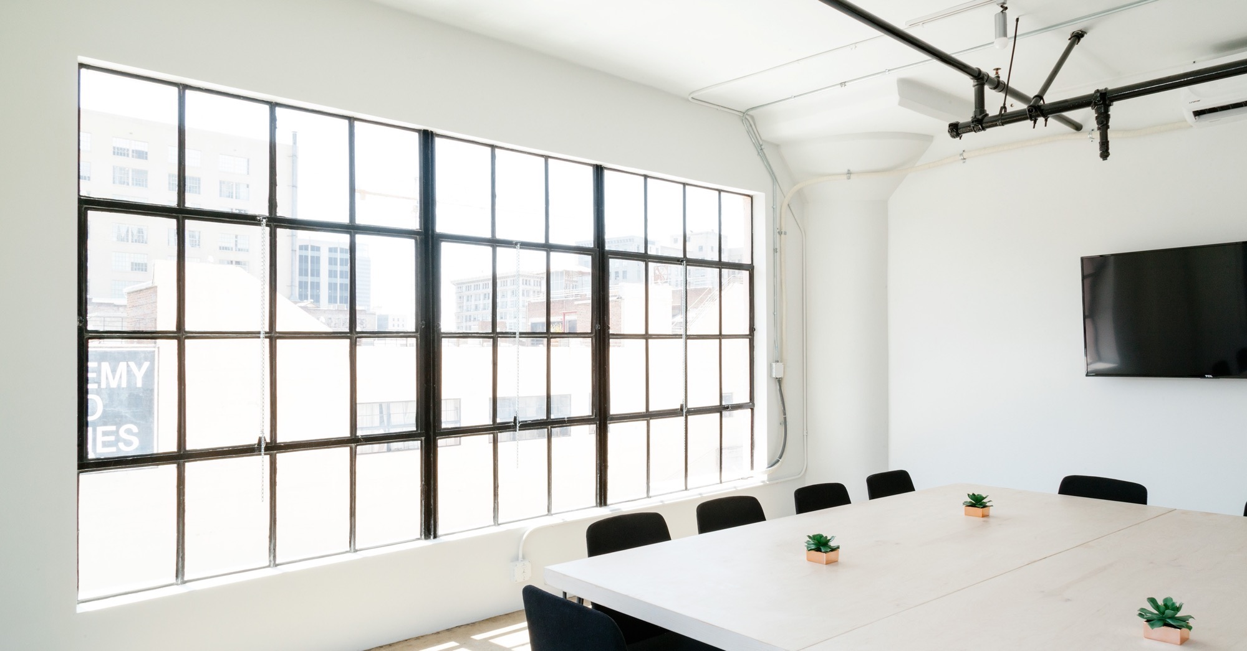
Large image
Chairman
Engin COBAN
CEO
Olgar SUNER
BOARD OF DIRECTORS
Consulting
Ramazan DEMIRTAS
Tourism
Sadi KUMTAS
Venture Group

Slide 8





Thank You
Olgar SUNER
+90697 092 8436
osuner@korendy.gr
Venture Group
Venture Group

